Slide 1
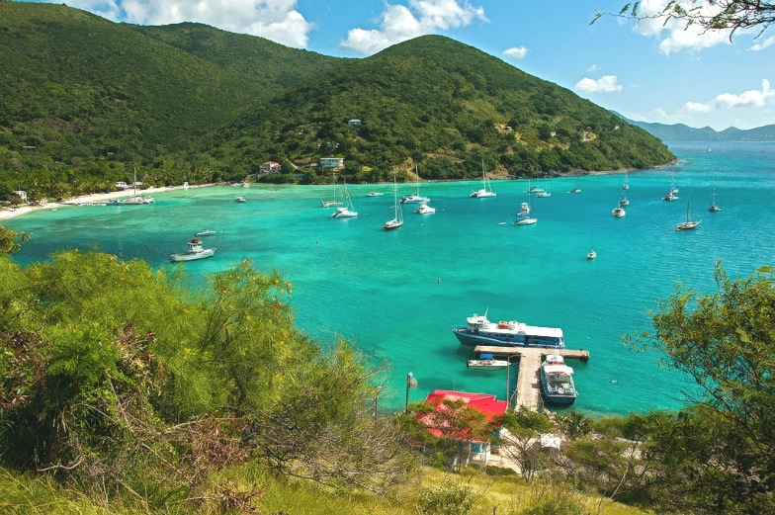
Climate Change and the Caribbean

Slide 2
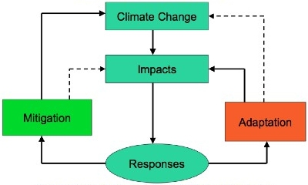
The Language of Climate Change

Slide 3
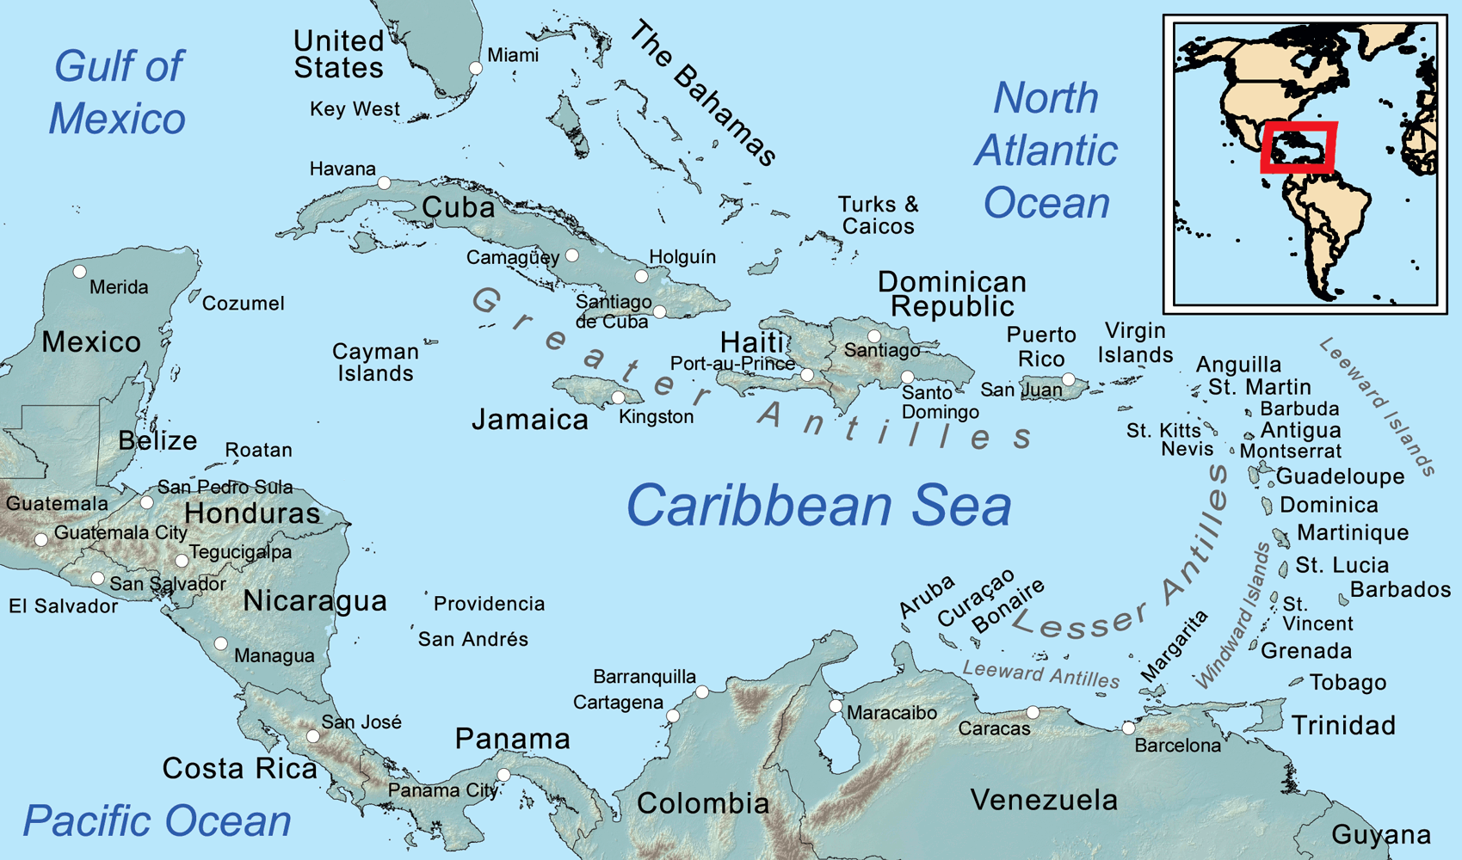
What thoughts come to your mind when you think about the Caribbean and Climate Change?

Slide 4
Climate Change – Caribbean Situation
https://www.youtube.com/watch?v=NkJQM8Ihad4
Caribbean Community Climate Change Center, Belize

Slide 5
Regional Sensitivity to Climate Change
Region is already under ecological, economic stress
Ecological services based on a limited and fragile resource base
Socioeconomic factors (e.g. the openness of trade in goods and services, high density populations)
Geographic realities of small physical dimensions
Climate Change Impacts exacerbate present stresses and create new ones

Slide 6
Climate Variability and Observed Impacts
The Caribbean has experienced significant sequences of climate events in the last 10-15 years.
Highest hurricane activity (2005-2008)
Highest rise in sea surface temperatures
Most widespread, severe drought (2009-2011)
Direct effects of high intensity and frequency of extreme weather events plus linkages with natural cyclical events such as El Nino.

Slide 7
Potential Impacts
With a 1.5ºC - 2.0ºC rise in global temperature:
Decreased length rainy season; increased length dry season (~10% by 2050)
~20% increased frequency of intense rains
30-50cm seal level rise by 2080
Increased intensity and strengthened hurricanes
Increased aridity and drought in prone areas

Slide 8
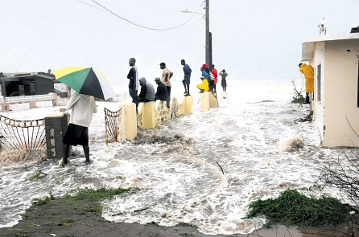
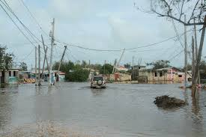
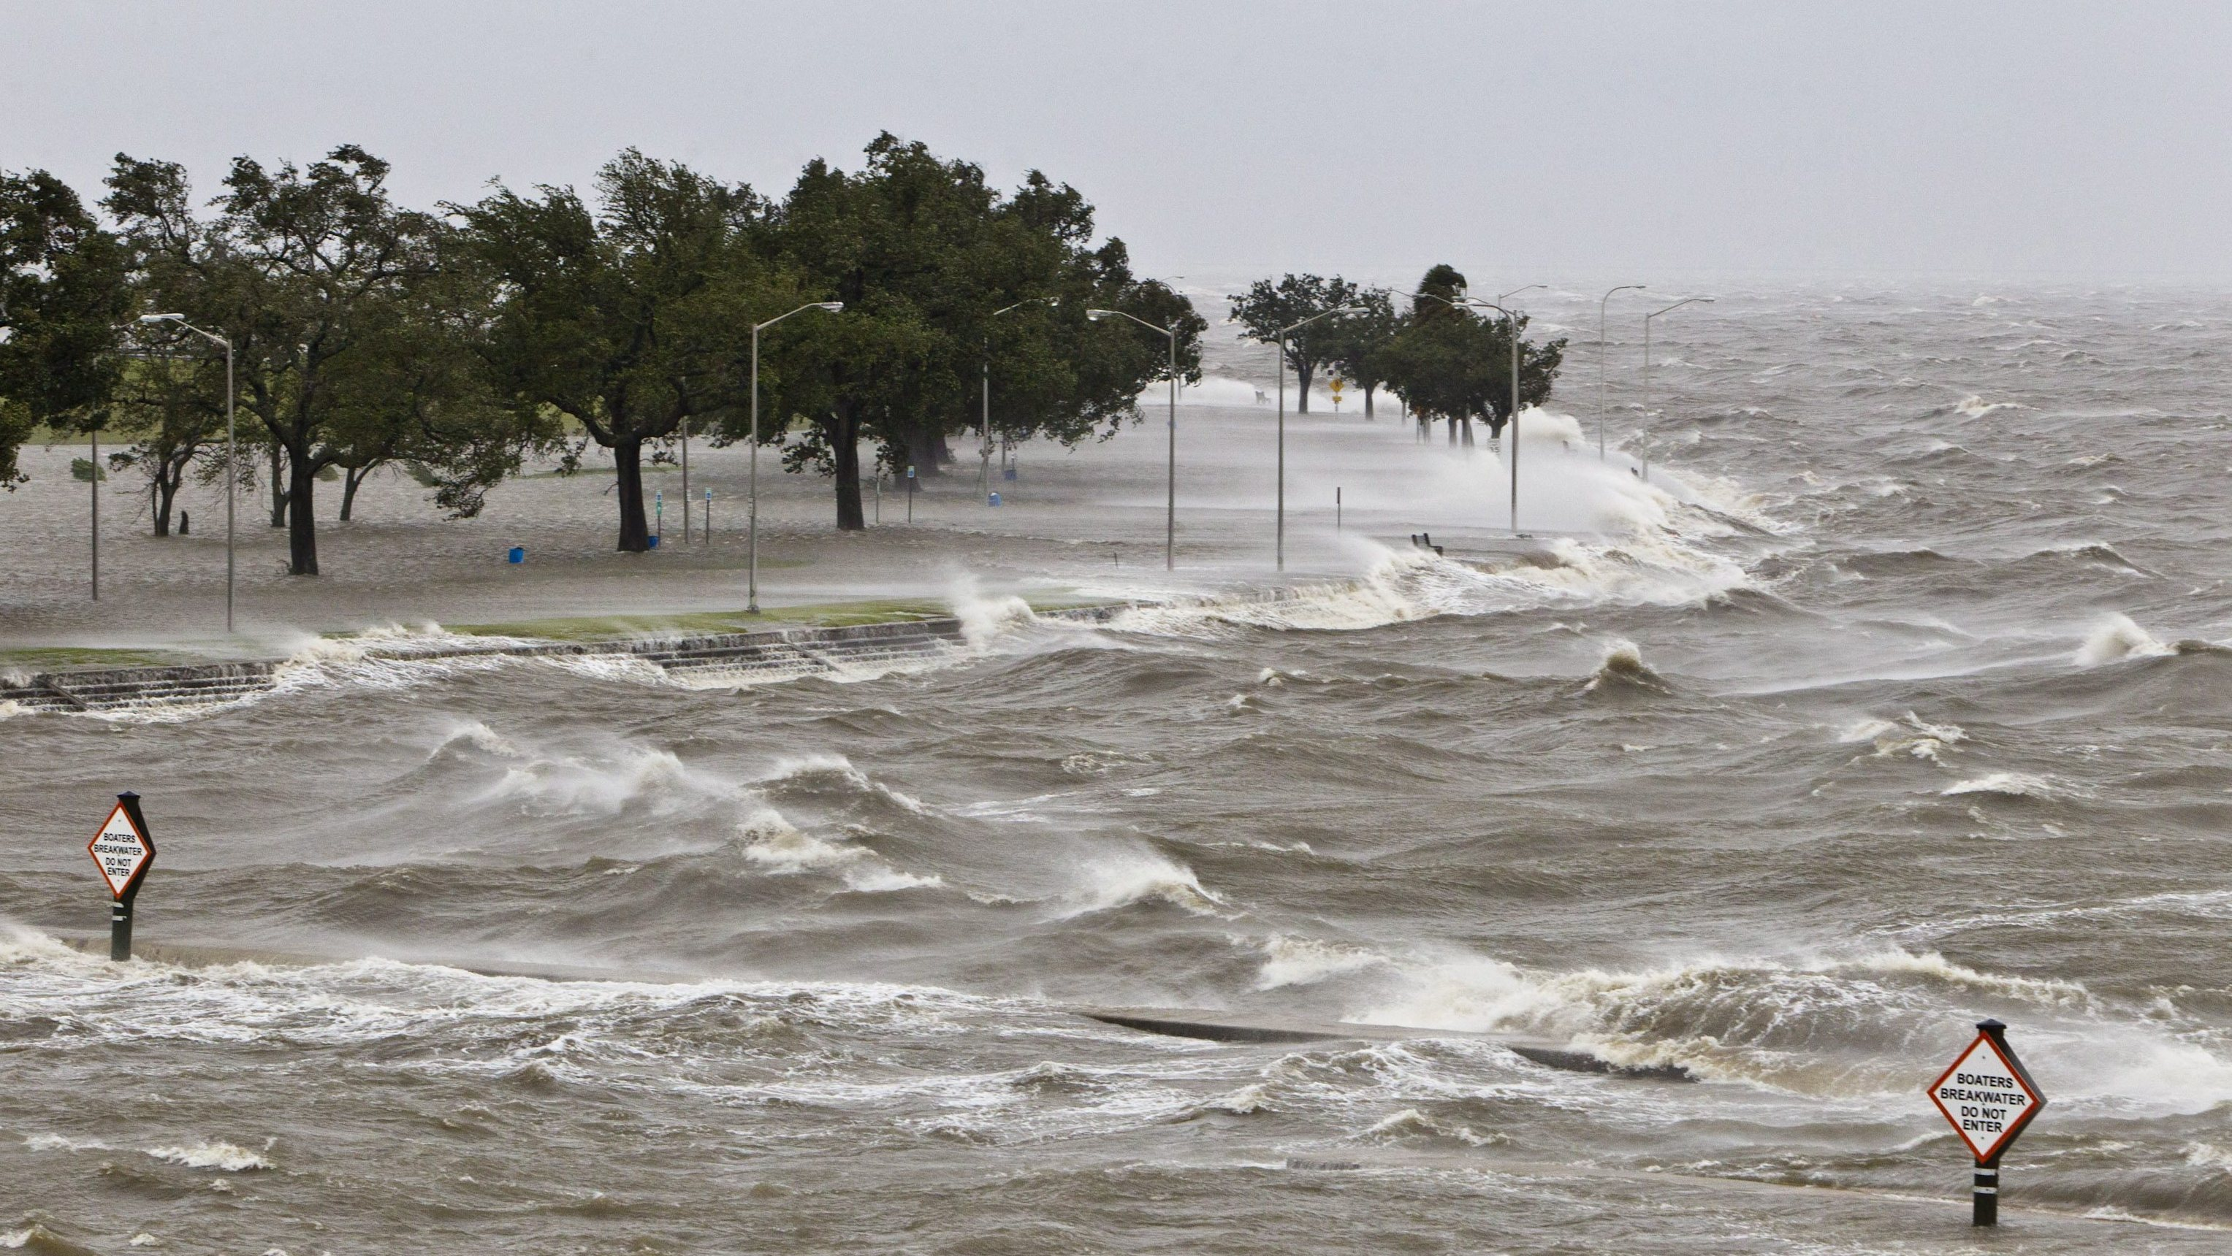
Sea Level Rise and Storm Surge

Slide 9
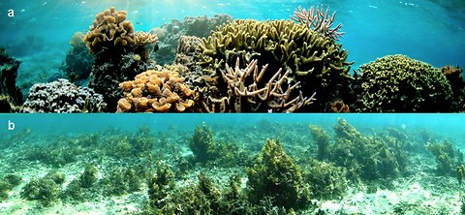
Ocean Acidification and Coral Reefs
Coral bleaching + ocean acidification

Slide 10
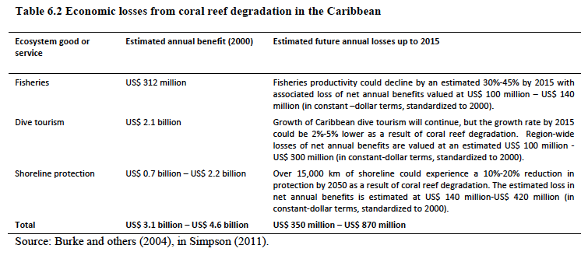

Slide 11
Impacts on Tourism
Direct Climate Impacts e.g. length and quality of tourist season,
weather extremes, food and water supply and the overall impact
of these on tourism demand
Indirect Environment Change Impacts e.g. water availability,
bio-diversity loss, altered agricultural production, increased
hazards, coastal erosion and inundation, increase in vector-borne
Diseases
Impacts of Mitigation Policies on Tourist Mobility: Mitigation
policies to Reduce GHG emission and the impact on tourist flows
and cost of transport
Indirect Societal Change Impacts: potential economic impact
to mitigate CC measures resulting in curtailed economic growth
and less discretionary income to grow tourism

Slide 12
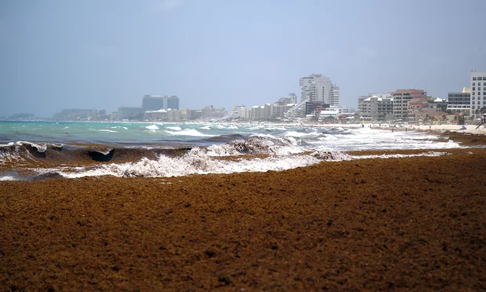
Sargassum: Unexpected Impact

Slide 13
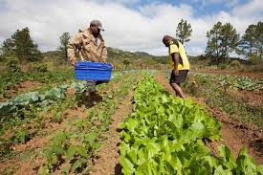
Agriculture, Fisheries, Food Security
https://www.youtube.com/watch?v=V-Z_AqgrR8M

Slide 14
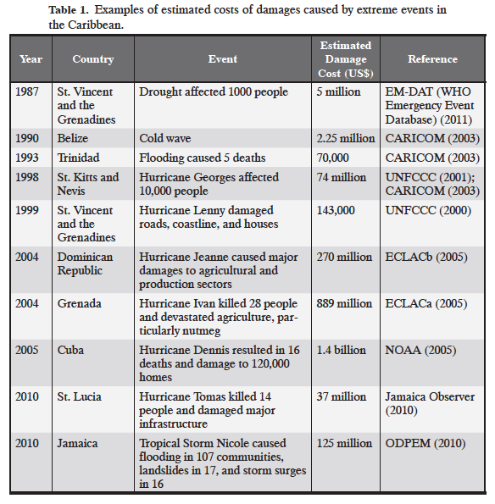

Slide 15
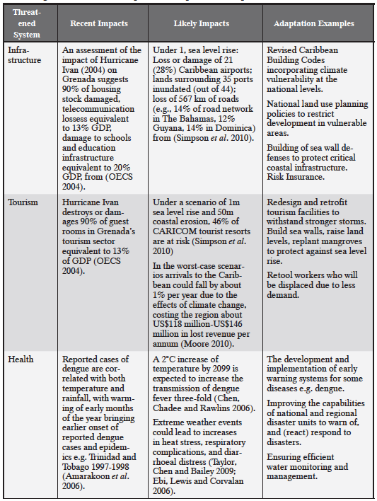

Slide 16
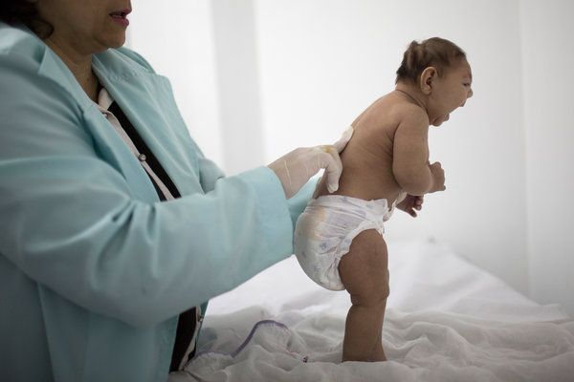
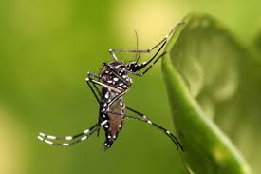
Theory becomes reality: Dengue, Zika
Over the coming decades, global warming is likely to increase the range and speed of the life cycle of the particular mosquitoes carrying these viruses, encouraging their spread deeper into temperate countries like the United States.

Slide 17
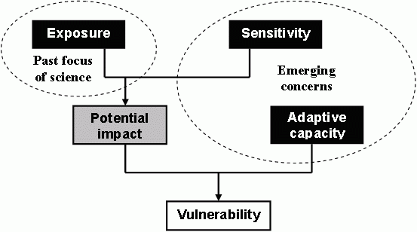
Developing adaptive capacity
IPCC, 2007

Slide 18
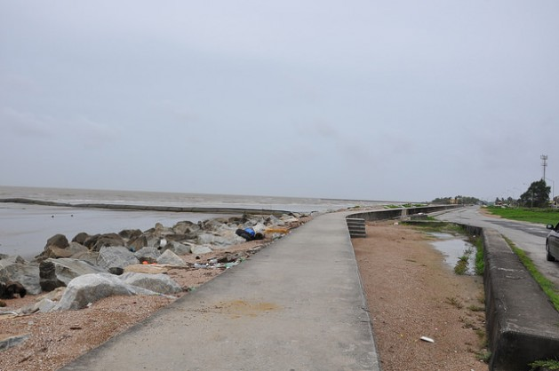
Sea walls, like this one in the Bahamas, serve to protect areas of human habitation, conservation and leisure activities from the action of tides and waves.

Slide 19
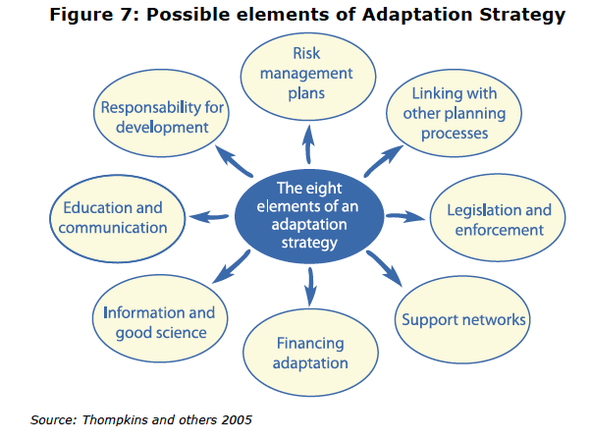

Slide 20
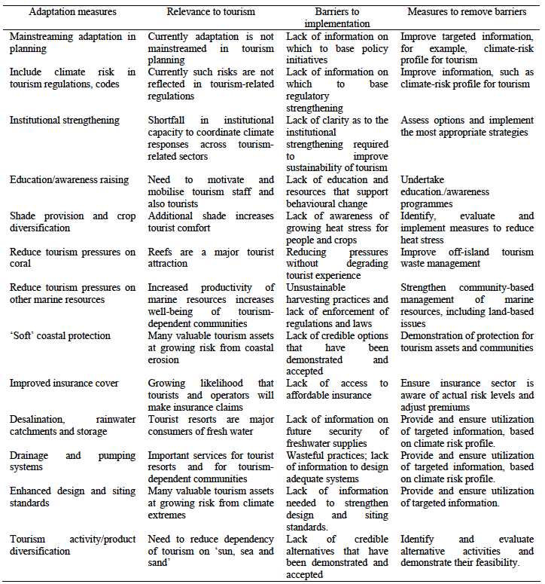
Tourism
Sector

Slide 21
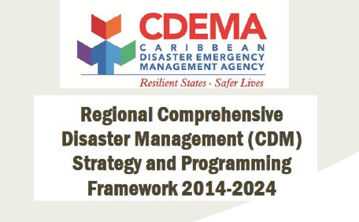
Risk Reduction
The concept and practice of reducing disaster risks through systematic efforts to analyze and manage the causal factors of disaster, including through reduced exposure to hazards, lessened vulnerability of people and property, wise management of land and the environment and improved preparedness for adverse events

Slide 22
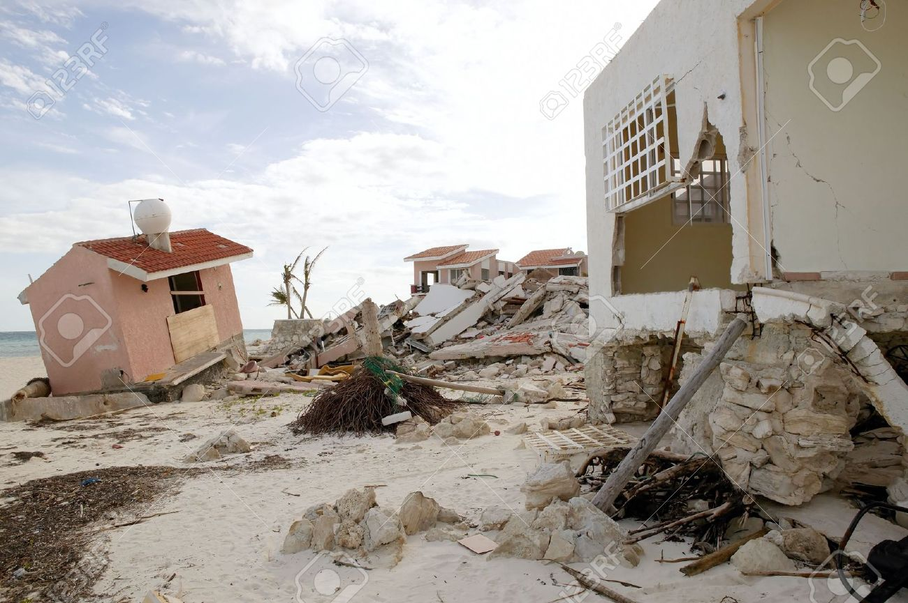
CCRIF
TOTAL PAYOUTS (US$) 2007-2015 = 37,972,474
the Caribbean Catastrophe Risk Insurance Facility was formed as the first multi-country risk pool in the world, and was the first insurance instrument to successfully develop parametric policies backed by both traditional and capital markets. It was designed as a regional catastrophe fund for Caribbean governments to limit the financial impact of devastating hurricanes and earthquakes by quickly providing financial liquidity when a policy is triggered.

Slide 23
CARICOM Climate Change Policy
This Strategy Document provides a road map for action:
Mainstreaming climate change adaptation strategies into the sustainable development agendas of the CARICOM States.
Promote actions to reduce greenhouse gas emissions through energy efficiency and conservation and switching to renewable energy sources.
Promote actions to reduce the vulnerability of natural and human systems in CARICOM states to the impacts of a changing climate.
Promote actions to derive social, economic and environmental benefits from the prudent management of standing forests in CARICOM states.

Slide 24
Mitigation of GHGs
Under the Kyoto Protocol SIDS including those in the Caribbean are not under obligation to mitigate or reduce greenhouse gas emissions or set national or regional targets
Countries across the globe committed to create a new international climate agreement by the conclusion of the U.N. Framework Convention on Climate Change (UNFCCC) Conference of the Parties (COP21) in Paris in December 2015.
In preparation, countries have agreed to publicly outline what post-2020 climate actions they intend to take under a new international agreement, known as their Intended Nationally Determined Contributions (INDCs).

Slide 25
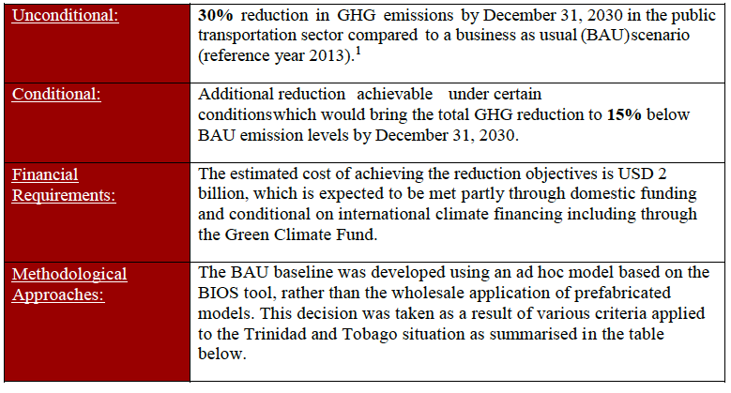
Example of INDC commitments: Trinidad & Tobago

Slide 26
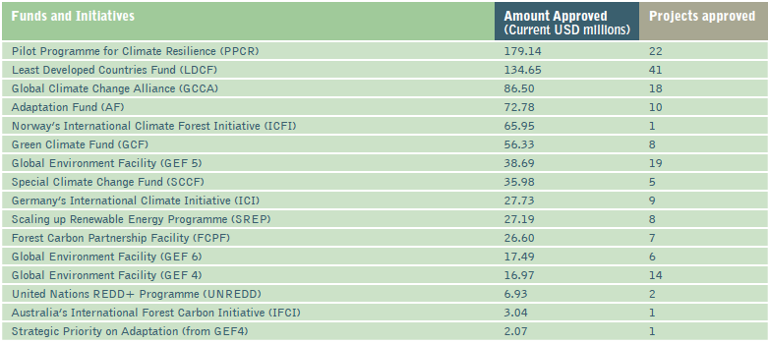
Climate Financing - SIDS

Slide 27
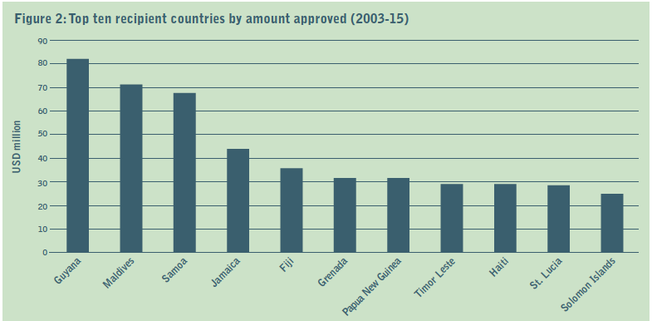
Climate Financing - SIDS

Slide 28
Non-Governmental Actors

Slide 29
End. Thank you.

