Slide 1
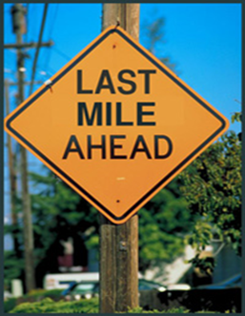
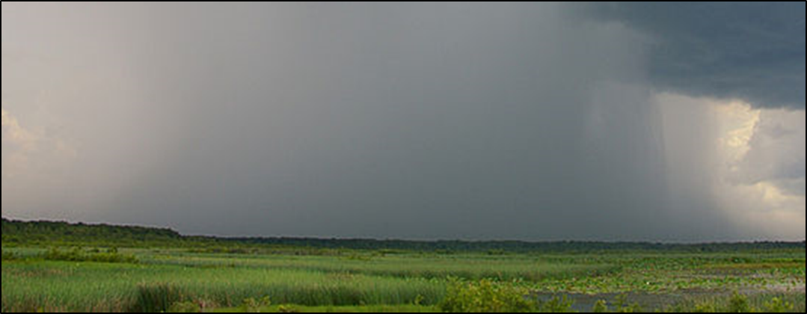
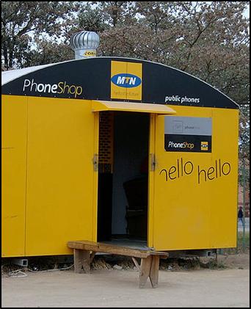
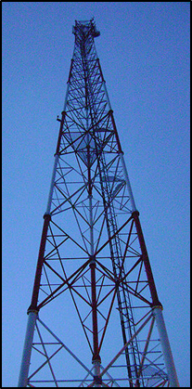
Building the Last Mile with
Public Private Partnerships
A New Vision for Weather and Climate Services in Africa
Alan Miller
C4 EcoSolutions
UNDP-CIRDA Country Partner Project Manager Workshop, 15-17 March 2016, Livingstone, Zambia.

Slide 2
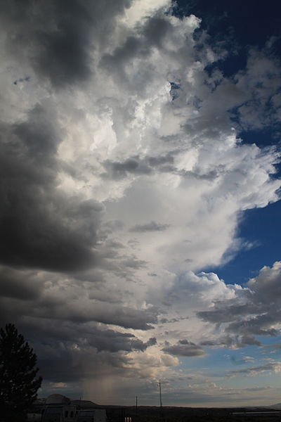
Traditional relationship with private sector one of buyer and seller
of equipment, limited after sale service
Public-Private Partnerships widely used for infrastructure and
more recently for private delivery of public services including
health and education – very different relationships
WMO Congress acknowledges potential benefits for weather and
climate services but warns against risks of “non-authoritative”
information that weakens mandate of NMHSs
WMO calls on NMHSs to develop “specifications and service level
agreements”

Slide 3
Some issues to think about:
Boundaries regarding ownership and use of data
Quality assurance and liability
Branding of information products
Public service obligations
Terms for marketing and outreach to potential end users
Revenue sharing

Slide 4
Think about a PPP as entering into a long-term relationship (like a marriage?)
Know your partner!
Anticipate ups and downs, be prepared to adapt
What works for one couple (country) may not work for others, solutions will need to be country (and sector) specific
As much as possible, strive to align interests

Slide 5
Thank You!
Alan Miller
astanley92@gmail.com

