Slide 1
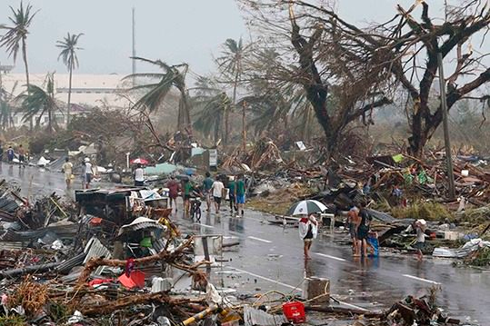
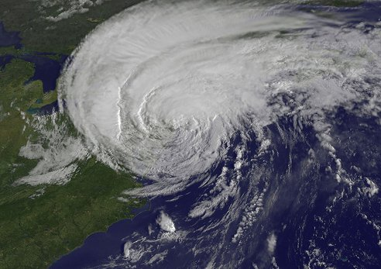
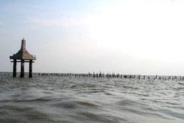
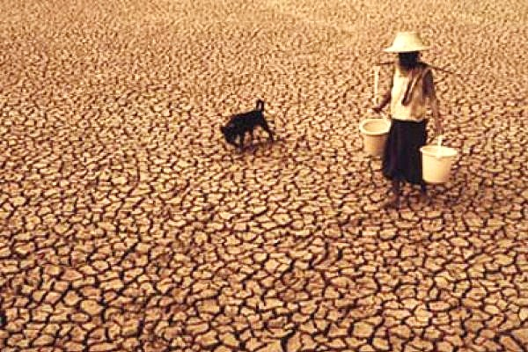
The 1st Draft of Thailand National Adaptation Plan
Extreme Weather Events
Sea Level Rise
Disaster
Drought
By Ms. CHOMPUNUT SONGKHAO
Policy and Strategy Section
Climate Change Management and Coordination Division
Office of Natural Resources and Environmental Policy and Planning

Slide 2
objective of the National Adaptation Plan
1. To provide government agencies and other related entities at the national and local levels with implementation framework, good practices, approaches, and guidelines for developing their own strategies, management plans, and action plans suitable for individual sectors and areas
2. To provide financial agencies with budget allocation framework
3. To lay a strong foundation and develop climate resilient approaches and readiness for the people to be able to adapt to climate change

Slide 3
The 1st Draft of Thailand National Adaptation Plan
Vision:
Thailand will be resilient to climate change impacts and has integrated adaptation measures to increase opportunities and capacities for the country to grow in a stable and sustainable way
Duration:
Long-term plan (5-Year Revision)
Mission:
1. develop database, research, knowledge, and technology for supporting climate adaptation actions
2. enhance capacities and awareness of development parties at all levels to ensure readiness for conducting the measures in accordance with climate change plans and policies
3. establish and incorporate climate resilience into the national development by promoting the integration of climate adaptation measures in all sectors and at all levels

Slide 4
Implementation Guidelines (Sectors)
1. Flood & drought and water management
2. Agriculture and food security
3. Tourism
4. Public health
5. Natural resource management
6. Human settlement and security

Slide 5
Goals
sectors | Goals
Water Management | 1. Balanced management between water supply and water usage of all river basins
 | 2. Resilience and readiness for coping with and reducing damages from floods and droughts
Agriculture and Food Security | 1. Resilience and readiness for tackling natural disasters in agricultural sector
 | 2. Food security at all levels
Tourism Management | 1. Development and promotion of ecological and sustainable tourisms for travelling options that help reduce climate
 | 2. Adaptive capacity to reducing disaster and climate risks
Public Health Management | 1. Surveillance mechanism and climate-related disease prevention
 | 2. Capacity building about public health system to address climate change
Natural resources Management | 1. Abundance preservation of natural resources and ecosystem on land
 | 2. Sustainable management of marine and coastal resources
Human Settlement and Security | 1. Reduction of risks and damages caused by natural disasters to settlement areas
 | 2. Communities prepared for adapting to climate change

Slide 6
6 Strategies – 16 Work plans
integrated and balanced water management in river basin systems
creation of readiness for tackling and reducing damages caused by droughts and floods
Water management
Agriculture and
food security
creation of resilience and readiness for adapting and addressing natural disaster risks
maintaining of food security
development of agricultural technology for economic value addition
Tourism management
development and promotion of ecological and sustainable tourism
adaptive capacity to mitigate risks from disasters and climate change
Public health
management
The development of surveillance mechanism and climate-related disease prevention
The development of public health system capacity and the promotion of the public's accessibility to quality public health services
Natural resource
management
preservation and restoration of natural resources and land ecosystem
management of marine and coastal resources
Human settlement
and security
reduction of natural disaster risks and damages
creation of readiness and adaptive capacity of the communities

Slide 7
Strategy 1: Water Management
Work plan 1.1: The integrated and balanced water management in river basin systems
formulate/improve database system regrading the amount of water supply and water demand in all sectors
Assess/foresee the impacts on water quantity and the possibility of changes in water flow and the distribution of water sources
Promote/support the participatory process in determining water management plans and policies with climate change taken into account
manage the Choa Phraya river basin
Work plan 1.2: The creation of readiness for tackling and reducing damages caused by droughts and floods
restore catchment forest areas to help slow down water flow and increase water absorption
provide additional water supply and develop water diversion projects as well as water grid
formulate master plan on water resources infrastructure to promote conjunctive use
develop drought and flood solutions by adding water into groundwater sources

Slide 8
Strategy 2: Agriculture and food security
Work plan 2.1: The creation of resilience and readiness for adapting and addressing natural disaster risks
manage cultivation zoning
map agricultural risk areas to be disseminated to farmers
improve and develop agricultural early warning
establish the network of surveillance and monitoring climate change impacts
Work plan 2.2: The maintaining of food security
protect the areas suitable for agriculture together with infrastructure investment
develop and support the prevention and the coping with natural disasters impacted on agriculture
support new theory agriculture in parallel with environmentally-friendly agriculture
develop research and knowledge on biotechnology and genetic bank
Work plan 2.3: The development of agricultural technology for economic value addition
develop and promote organic farming products
leverage processed agricultural industries with the use of innovation and technology to boost efficiency

Slide 9
Strategy 3: Tourism management
Work plan 3.1: The development and promotion of ecological and sustainable tourism
promote ecological, cultural, and sustainable tourism
promote environmentally-friendly management and activities
develop tourist modalities with regard to changing climate-concerned infrastructures and facilities
build capacities of local administrations, tourist businesspeople, and communities about on ecotourism and sustainability
attach importance to sustainable marketing
Work plan 3.2: The adaptive capacity to mitigate risks from disasters and climate change
devise local standard tourist development plans
devise suitable tourist development plans which include the evaluation of water usage efficiency
develop early warning systems and evacuation plans

Slide 10
Strategy 4: Public health management
Work plan 4.1: The development of surveillance mechanism and climate-related disease prevention
develop the network of early warning and surveillance in risk areas and population
improve health insurance systems to cover climate-risk/vulnerable population
develop prototype communities in risk areas
Work plan 4.2: The development of public health system capacity and the promotion of the public's accessibility to quality public health services
promote the roles and the capacities of public health personnel at all levels to address climate change in a proactive manner
develop climate-related health database and information technology at national level
develop collaborative mechanism in all sectors both within and without the public health circle

Slide 11
Strategy 5: Natural resource management
Work plan 5.1: The preservation and restoration of natural resources and land ecosystem
preserve and protect conserved forest areas
conserve and restore catchment forest areas that are degraded and invaded in order to create a balance on ecosystem in the catchment areas
conserve high-biodiversity forest areas
promote and bolster reforestation to augment forest areas
promote and develop eco-villages
Work plan 5.2: The management of marine and coastal resources
protect coastal areas by reforestation to increase mangroves
conserve and accelerate the restoration of marine and coastal resources to maintain ecosystem balance
monitor, control, and crackdown to reduce deforestation
enhance knowledge of public network, communities, local administrations to help restore coastal areas with use of natural systems

Slide 12
Strategy 6: Human settlement and security
Work plan 6.1: The reduction of natural disaster risks and damages
study and review the feasibility of the enforcement and the development of specific city plans in climate risk areas for long-term solutions
develop the infrastructures necessary for coping with emergencies as the result of natural disasters
establish flood and landslide early warning
prevent floods in urban areas and resolve floods in specific areas as requested by locals
Work plan 6.2: The creation of readiness and adaptive capacity of the communities
survey and check existing infrastructures and buildings that hamper water runoff in order to analyze, redesign, and restructure them
support and promote the coping capacities of local administrations to be prepared for floods along rivers and tributaries
promote locals to initiate adaptation plans, together with the determination of vision and urban development strategies

Slide 13
Preparation Approach for the Implementation of National Adaptation Plan
The readiness and capacity building of all stakeholders involved in the country
The development of database, knowledge, and research to support the implementation and the monitoring
The promotion of integrated and collaborative implementation across relevant agencies and sectors
The institution rearrangement, the public management system, the development of supporting mechanisms, and the budget allocation

Slide 14
Thank You
Policy and Strategy Section
Climate Change Coordination and Management Division
Office of Natural Resources and Environmental Policy and Planning
Rama VI Rd., Phayathai District, Bangkok 10400 Thailand
T/F: +66 2265 6692, +66 2265 6500 ext. 6842
climate.onep.go.th

